Slide 1
Indo- PaK Relations
Dissolution of the British Raj in 1947
Two new sovereign nations were formed
Violent partition and numerous territorial claims overshadow their relationship
Two countries have fought three major wars (1965,1971,1999)
Involved in numerous armed skirmishes and military standoffs.
2003 ceasefire agreement and the Delhi–Lahore Bus service were successful in de-escalating tension
2001 Indian Parliament attack
2007 Samjhauta Express bombings
2008 Mumbai attacks
2016 terrorist attack on an Indian military base- severe blow to the ongoing India-Pakistan peace talks

Slide 2
Seeds of conflict
Kashmir conflict
Kashmir was a Muslim-majority princely state, ruled by a Hindu king, Maharaja Hari Singh
Ruler of the state, preferred to remain independent and did not want to join either two.
Despite the standstill agreement with Pakistan, Pakistani forces were dispatched into Kashmir - "Operation Gulmarg" to seize Kashmir
Maharaja turned to India and requested India for troops to safeguard Kashmir
Maharaja advised to sign Instrument of Accession before India could send its troops. (26 October 1947)
Indian troops were airlifted from Delhi, on 27 October 1947
Indian troops managed to evict the aggressors from parts of Kashmir
But the onset of winter made much of the state impassable.
Declared a ceasefire and sought U.N. arbitration with the promise of a plebiscite
north-western Kashmir- Azad Kashmir- PoK
Line of Control (LoC) military control line between the Indian and Pakistani Simla Agreement, signed on 3 July 1972

Slide 3
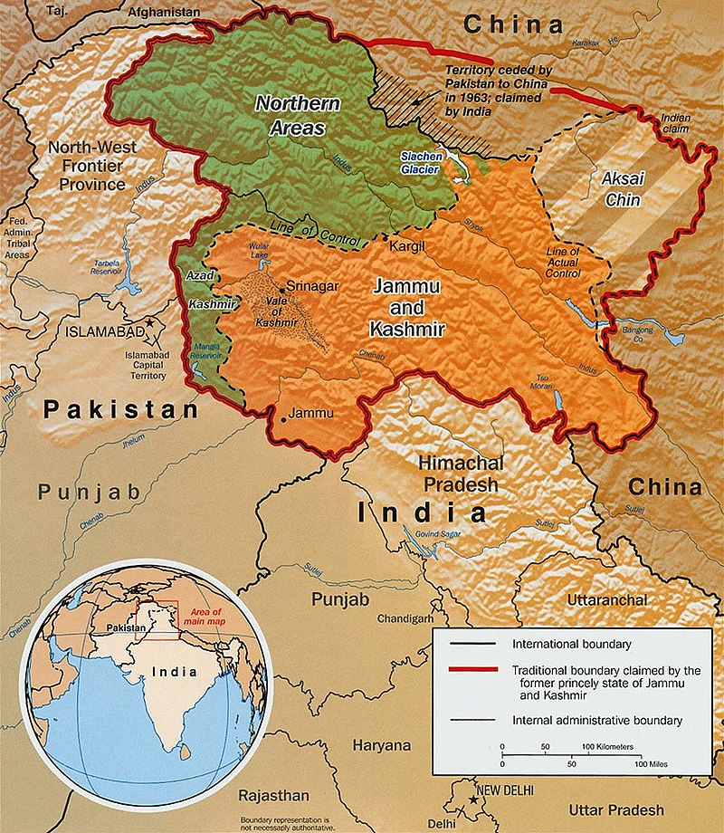

Slide 4
War of 1965
started following Pakistan's Operation Gibraltar
designed to infiltrate forces into Jammu and Kashmir to precipitate an insurgency against rule by India
ended in a United Nations (UN) mandated ceasefire and the subsequent issuance of the Tashkent Declaration
War of 1971
geo-politically divided into two major regions, West Pakistan and East Pakistan
East Pakistan was occupied mostly by Bengali people.
13 days after the invasion of East Pakistan, 90,000 Pakistani military personnel surrendered to the Indian Army
After the surrender of Pakistani forces, East Pakistan became the independent nation of Bangladesh.
Kargil War
During the winter months of 1998-99, the Indian army vacated its posts at very high peaks in Kargil sector in Kashmir as it used to do every year.
Pakistani Army intruded across the line of control and occupied the posts

Slide 5
Main Agreements Signed
Indus Waters Treaty:960 by Prime Minister of India Jawaharlal Nehru and President of Pakistan Ayub Khan.
Tashkent Declaration was a peace agreement between India and Pakistan signed on 1966 that resolved the Indo-Pakistani War of 1965.
Lal Bahadur Shastri and Pakistani President Muhammad Ayub Khan
Simla Agreement was signed between India and Pakistan on 2 July 1972 in Simla
Zulfiqar Ali Bhutto, the President of Pakistan, and Indira Gandhi, the Prime Minister of India
Lahore Declaration was a bilateral agreement 1999-Nawaz Sharif and Prime Minister Atal Bihari Vajpayee signed the treaty

